Slide 1
Object Oriented Programming
Class based vs prototype base inheritance
In class based: Classes are definition and can be made into distinct instances
In prototypes: There are no definitions, and instance delegate functionality to others
Inheritance, composition, delegation
Class inheritance, Interface implementation
Access modifiers, class definition, state, static
Encapsulation
Access modifiers
Encapsulated fields, read only properties
Polymorphism
Abstract, virtual
Composition vs inheritance

Slide 2
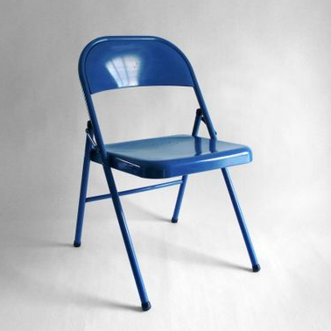
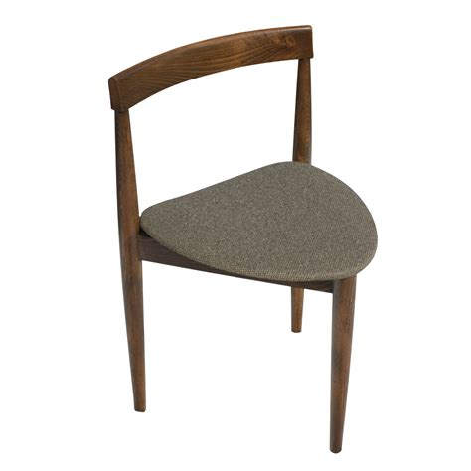
Inheritance, composition, delegation
We want to represent and work with chairs above. Swing chair. Four legged chair, Folding chair. Three legged chair.
Criteria
Support “Use” action
If legged, have “GetNumberOfLegs()”
If swinging, have “Swing” action
If folding, have “Fold” action
Interfaces vs Abstract Classes vs Class
Declared type vs Instance type
Implications of virtual/override/new
Open/Close principle
When is out design not open for extension?
Public static vs Private static
Why is one ok, but not the other?

